Slide 1



CNNs Vs GNNs_results

Slide 2

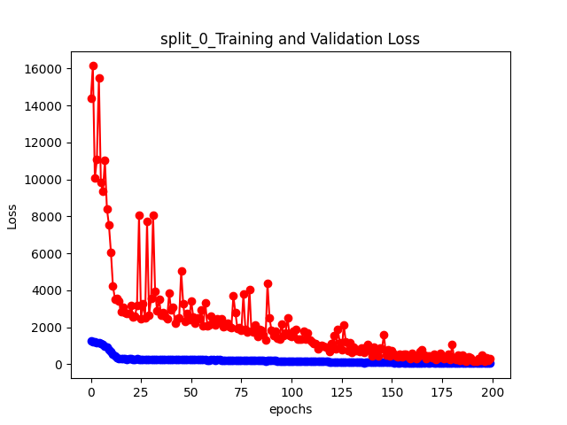
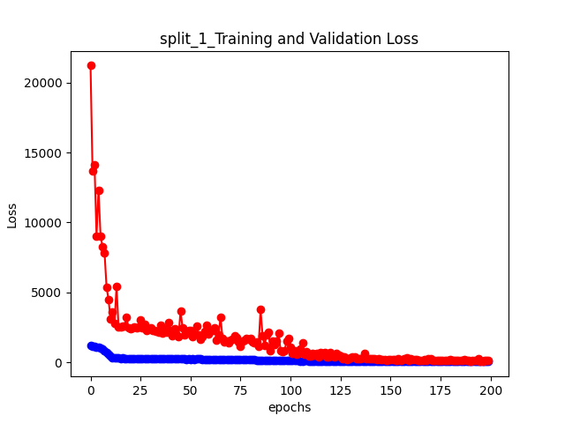
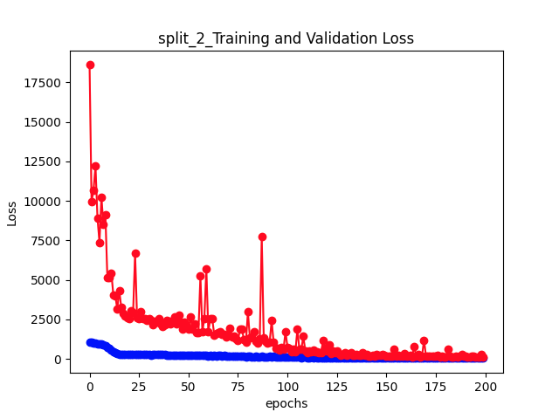
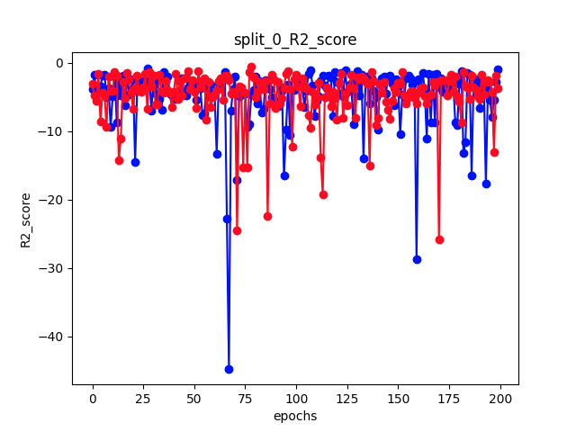
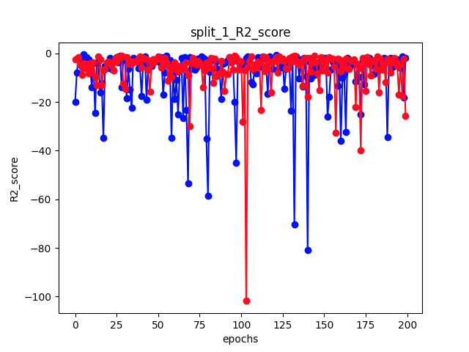
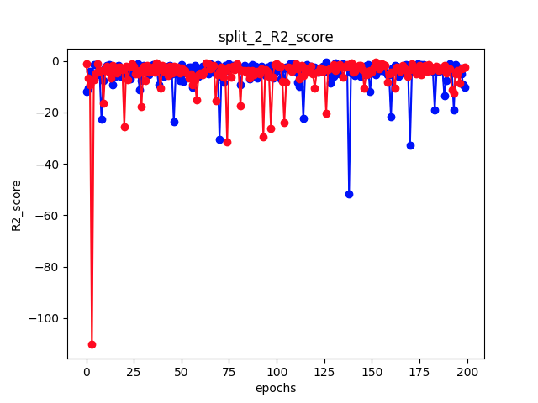
results , tiles size 250 x 250 pixels : (no dropout , no l1, Batch Normalization(1D),no weight decay)

Slide 3
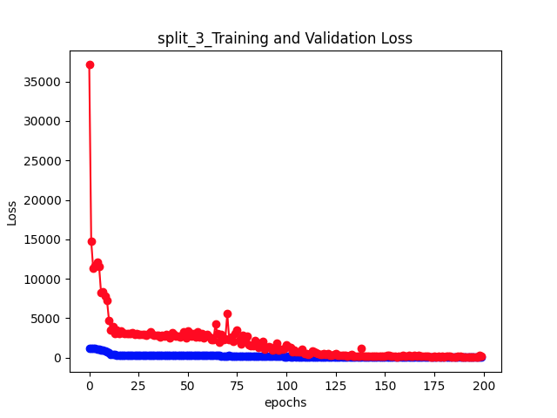
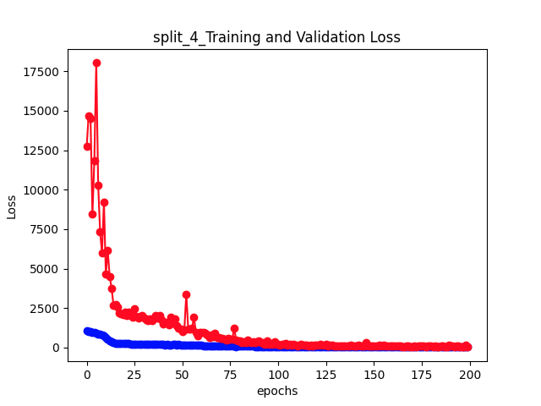
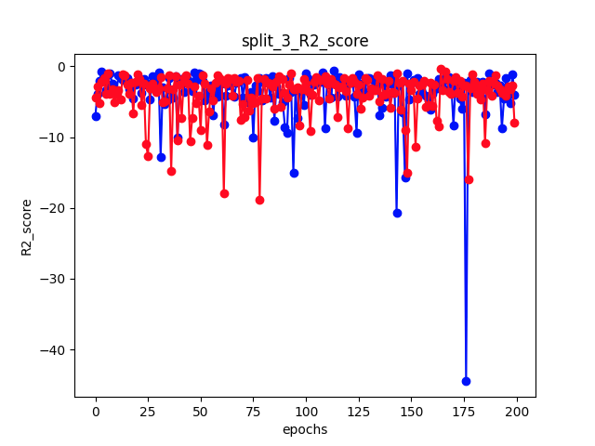
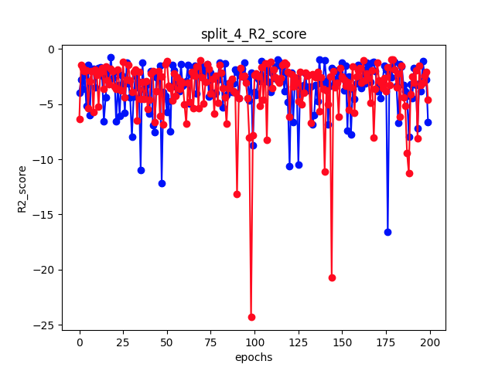
results , tiles size 250 x 250 pixels : (no dropout , no l2, Batch Normalization, no weight decay)

Slide 4
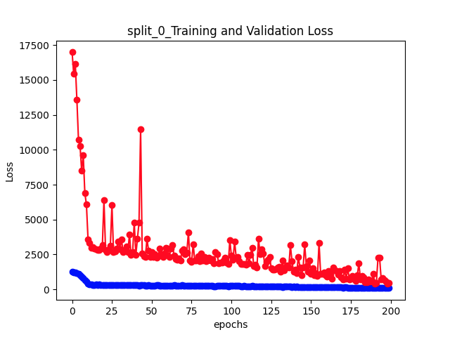
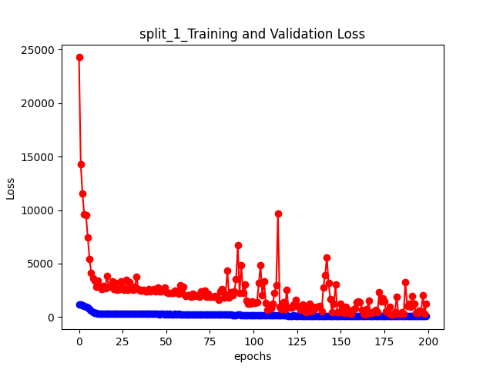
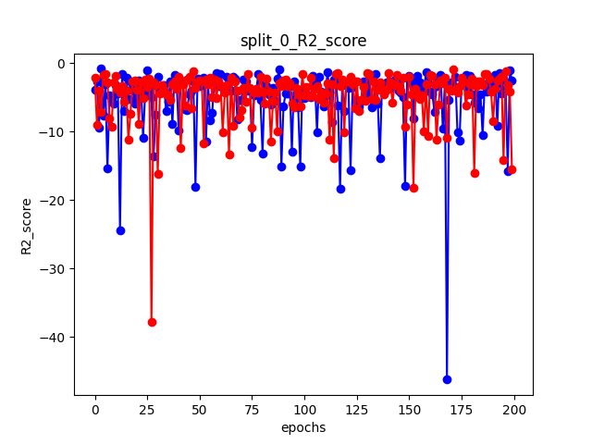
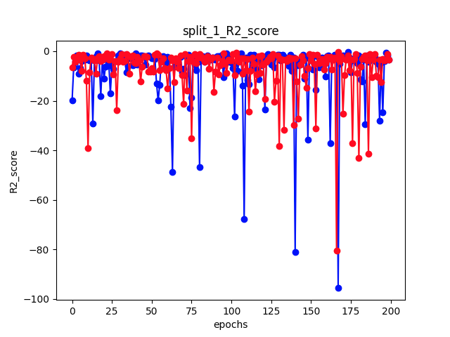
results , tiles size 250 x 250 pixels : (dropout , Batch Normalization(1D), no weight decay)

Slide 5
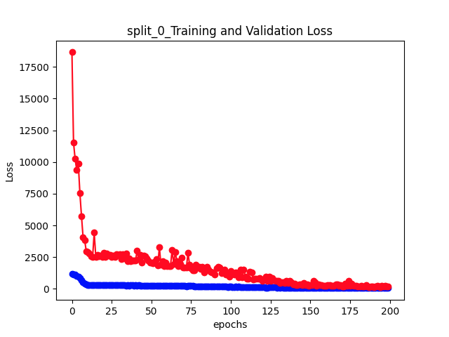


results , tiles size 250 x 250 pixels : (dropout , Batch Normalization(1D), weight decay)

Slide 6
results , tiles size 250 x 250 pixels : (dropout , Batch Normalization(1D), weight decay) + tuning

